Slide 1
Lesson objective
Need calculators, rulers and whiteboards.
Title: Bar graphs
Aim:
Be able to convert a frequency table into a bar graph
Plan:
Daily review: mean, mode and medina
Bar charts
Skills practice

Slide 2
Daily review
Statistical measures
Description
Mean
Mode
Median
Range
Spread of data, highest takes lowest.
Middle number
Most occurring
The average, sum of data points, divided by number of

Slide 3
Mean, mode and median practice
Calculate the mean, mode, median and range of the following data points. EXERCISE BOOKS!
4, 6, 6, 8, 9, 10, 15
120, 130, 155, 155, 200, 210, 215, 215, 215, 300
7, 2, 4, 1, 8, 3, 10, 7, 3, 5, 1, 0, 3, 5, 11

Slide 4

Bar Charts
Starter:
Complete the missing information in the table (Pictogram)
Favourite Subject
Pictogram
Frequency
Key:
= 4 people
Maths
8
English
10
DISCUSS
Science
9
Art
12
PE
14
History
7

Slide 5

Bar Charts
Starter:
Complete the Tally Chart Below
Favourite Animal
Tally
Frequency
Dog
Cat
Rabbit
4
Hamster
13
Other
6

Slide 6
Bar graph – copy in blue
Steps for Bar graph:
Draw axis
Label axis (y – dependent & x – Independent) and TITLE
Suitable scale (go up by 1s, 2s, 5s? look at the spread of data points)
Draw accurate bars for each independent variable

Slide 7
FREQUENCY
Draw axis
Label axis (y – dependent & x – Independent) and TITLE
Suitable scale (go up by 1s, 2s, 5s? look at the spread of data points)
Draw accurate bars for each independent variable
Favourite animal | Frequency
Dog | 7
Cat | 10
Rabbit | 4
Hamster | 13
Other | 6
Dog
Cat
Rabbit
Hamster
Other

Slide 8
Bar Charts:
Draw a bar chart for this set of data. WHITEBOARDS
Favourite Subject
Freq.
14
Frequency
13
Maths
8
12
11
English
10
10
Science
9
9
8
Art
12
7
6
PE
14
5
4
History
7
3
2
1
0
Maths
English
Science
Art
PE
History
a
Which subject was most popular?
PE
b
Work out the difference between PE and History.
14 – 7 = 7

Slide 9
Comparative bar charts
https://www.youtube.com/watch?v=miFLfeDS4P0
For the next activity, use the lines on the grid for each category. (see first data entered)

Slide 10
Comparative Bar Charts:
Fav. Sport | Football | Netball | Basketball | Tennis | Other
Boys | 8 | 2 | 5 | 3 | 2
Girls | 3 | 10 | 2 | 4 | 3
The information in the table shows the sports boys and girls in year 7 enjoy the most.
Key:
Boys
Girls
Frequency
10
9
a
Draw a bar chart
8
7
b
Using the bar chart work out the difference between the boys favourite sport and the girls favourite sport.
6
5
4
3
2
1
10 – 8 = 2
0
Football
Netball
Basketball
Tennis
Other

Slide 11
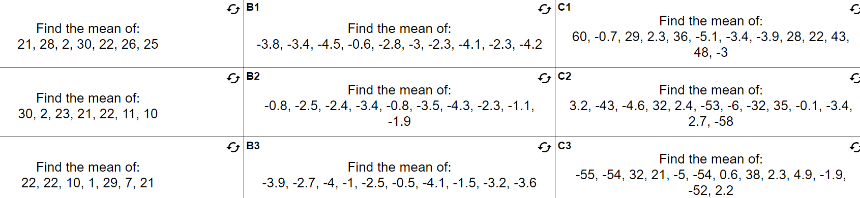
Mean practice

Slide 12
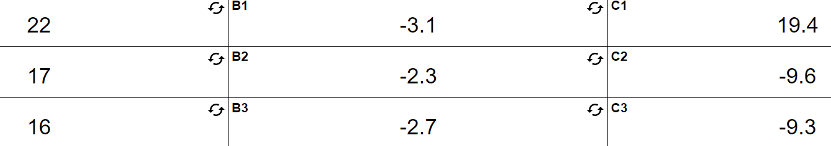
Answers

Slide 13
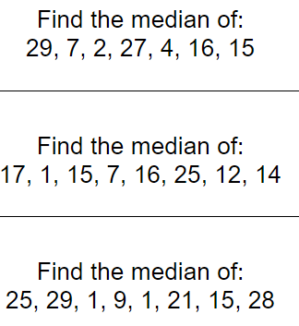
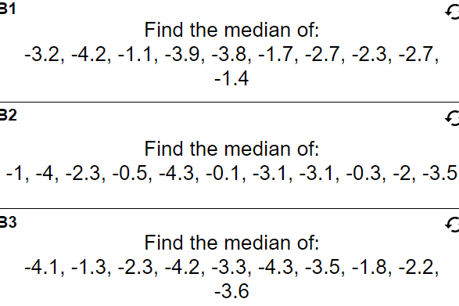
Median practice

Slide 14
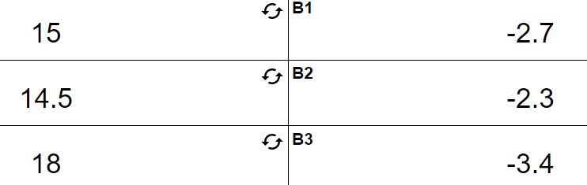
Answers

Slide 15
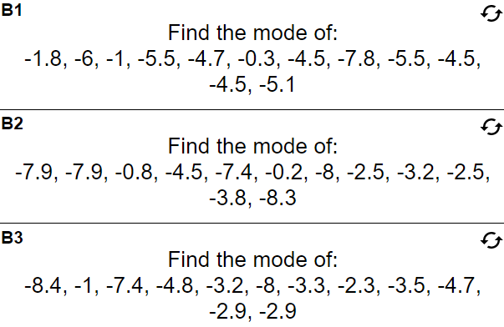
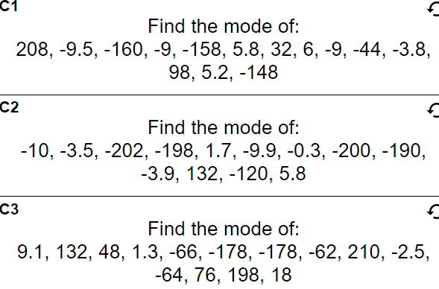
Mode practice

Slide 16
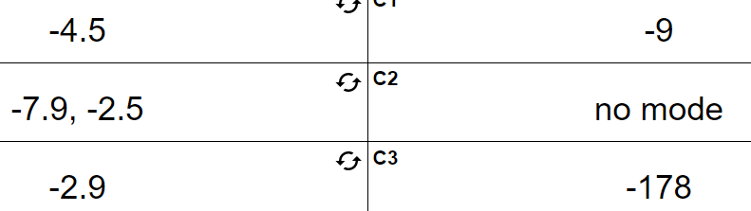
Answers

